Slide 1
Ansible F5 Network Workshop
Jim Garrett
Senior Solution Architect
jgarrett@redhat.com
September 2018

Slide 2
What You Will Learn
What is Ansible, its common use cases
How Ansible works and terminology
Running Playbook Basics
Network Modules
An Introduction to Roles
An Introduction to Ansible Galaxy

Slide 3
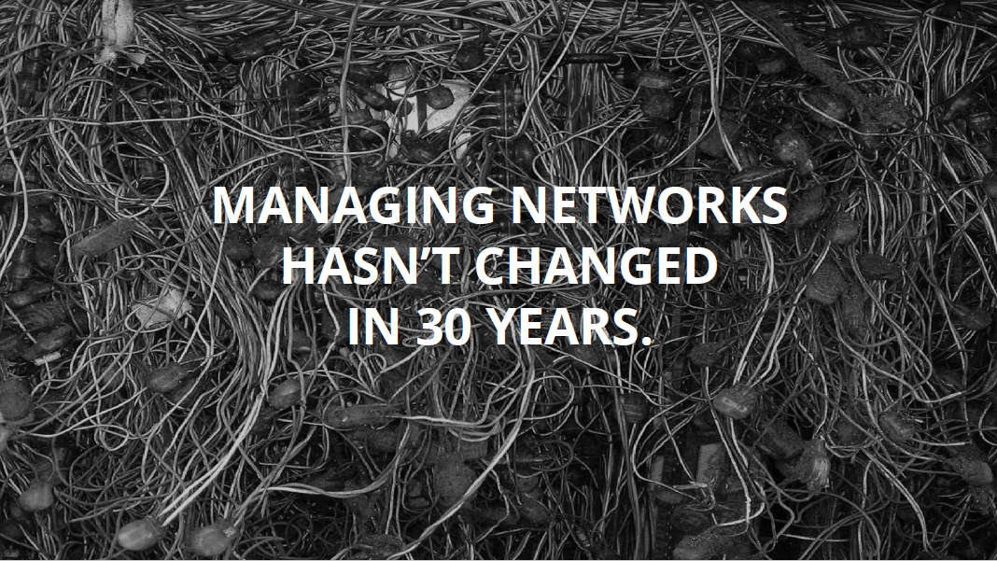

Slide 4
Managing networks hasn’t changed in 30 years
Networks are mission critical
Every network is a unique snowflake
Ad-hoc changes that proliferate
Vendor specific implementations
Testing is expensive/impossible

Slide 5
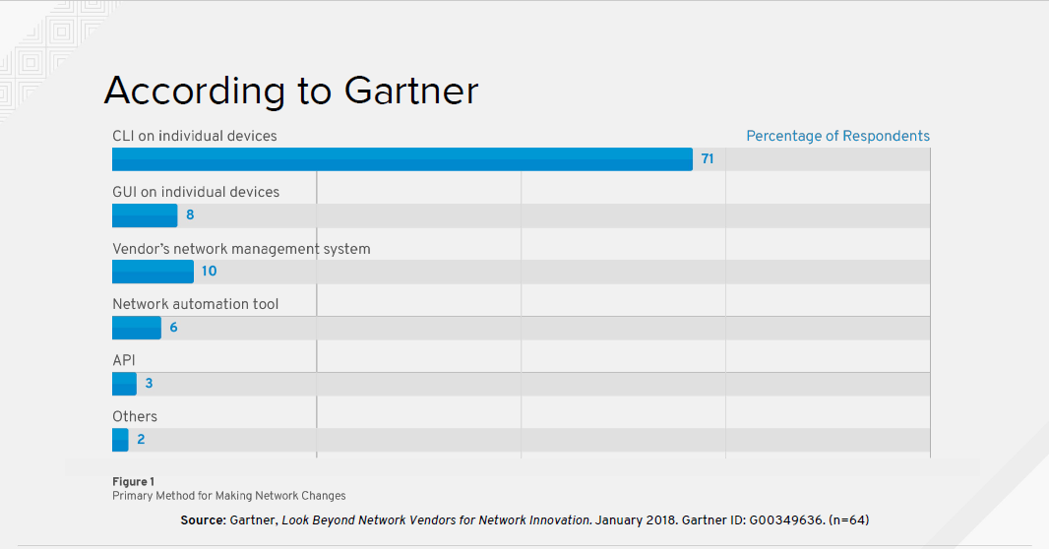
Notes:
Primary method for Making Network Changes

Slide 6
Automatic considerations
Compute is no longer the slowest link in the chain
Businesses demand that networks deliver at the speed of cloud
Automation of repeatable tasks
Bridge silos
Notes:
With the creation of the cloud demand has skyrocketed for faster delivery
The reality is that business demand that network configuration become a consistent, repeatable automation process

Slide 7
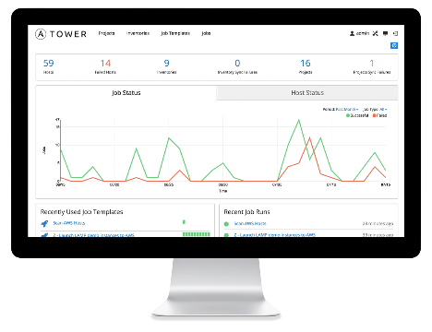
WHAT IS ANSIBLE?
It’s an automation engine - Ansible
Automate What????

Slide 8
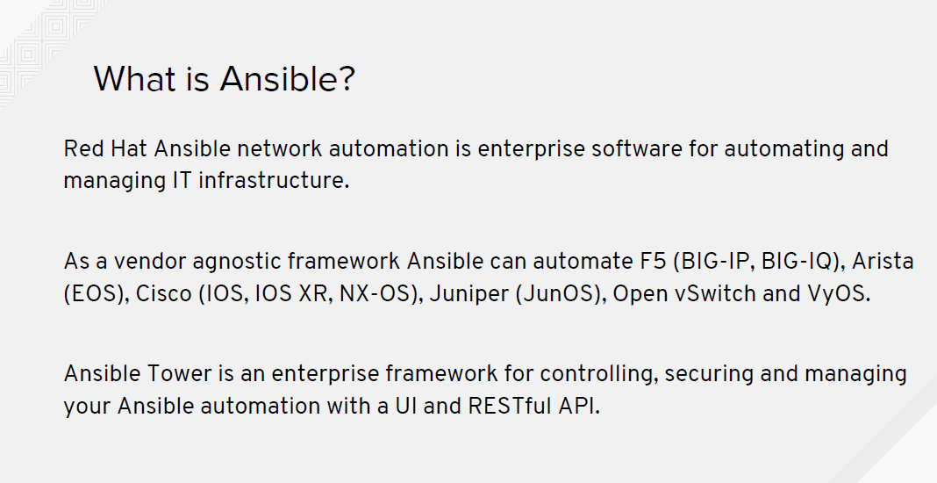

Slide 9
WHAT IS ANSIBLE?
It’s an automation engine - Ansible
It’s an automation language - Ansible Playbooks.
Enterprise framework for controlling, securing and managing your automation – Ansible Tower

Slide 10
SIMPLE
POWERFUL
Agentless
Human readable automation
No special coding skills needed
Tasks executed in order
Get productive quickly
Configuration management
App deployment
Workflow orchestration
Orchestrate the app lifecycle
Agentless architecture
Uses OpenSSH & WinRM
More efficient & more secure

Slide 11
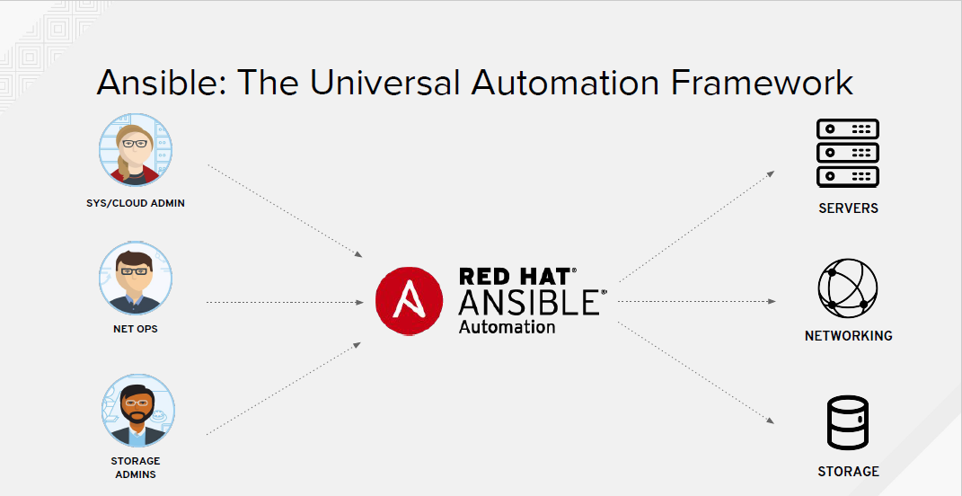
Notes:
Ansible is THE Universal Automation Framework that can be used to automate the provisioning and configuration of SERVERS, NETWORKS and STORAGE

Slide 12
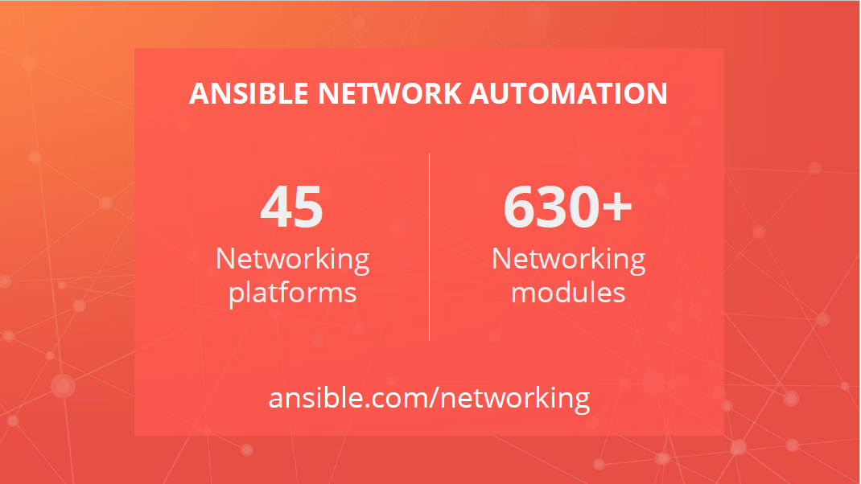

Slide 13
Common Use Cases
Backup and restore device configurations
Upgrade network device OS
Ensure Configuration Compliance
Apply patches to address CVE (Common Vulnerabilities and Exposures)
Generate dynamic documentation
Anything an operator can do manually, Ansible can automate

Slide 14
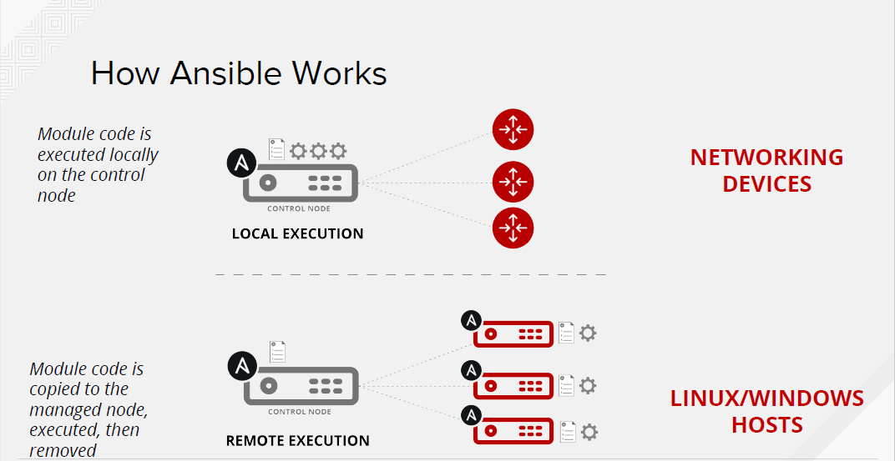

Slide 15
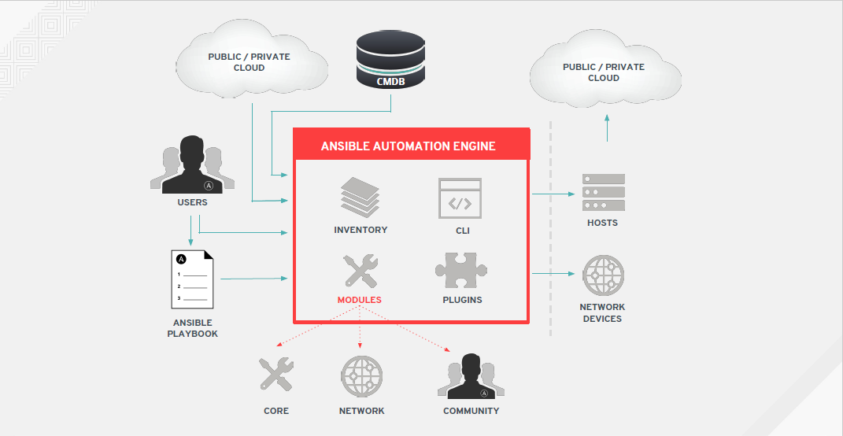

Slide 16
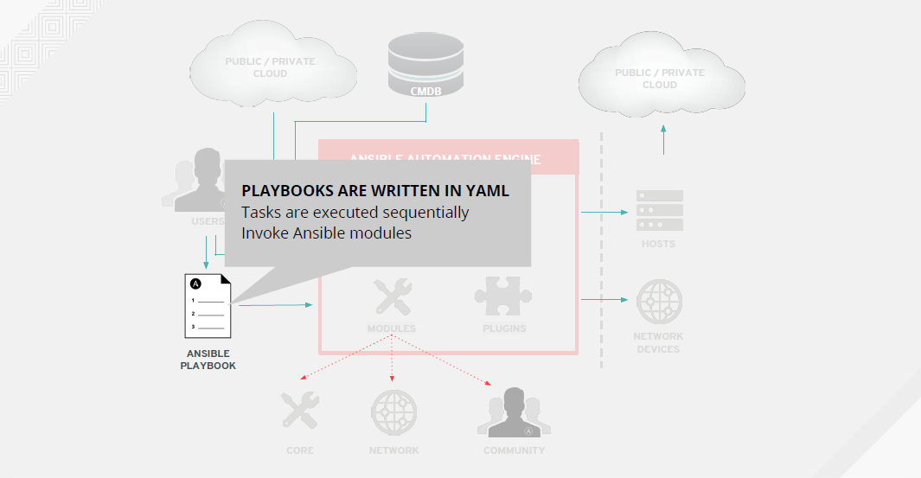

Slide 17
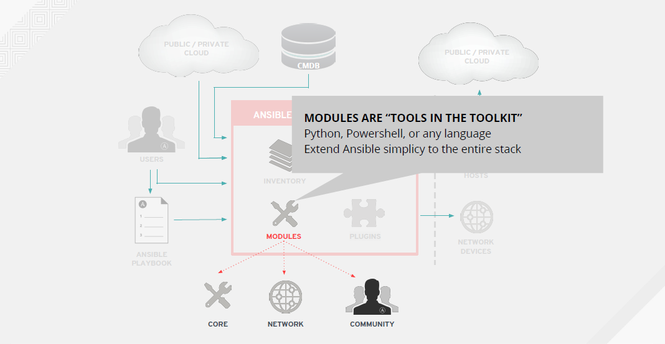

Slide 18
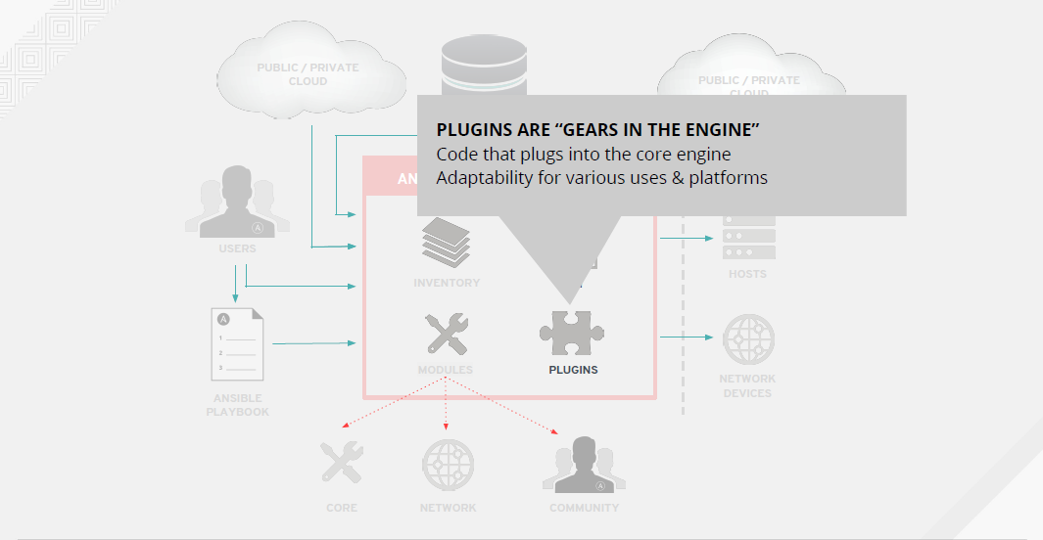

Slide 19
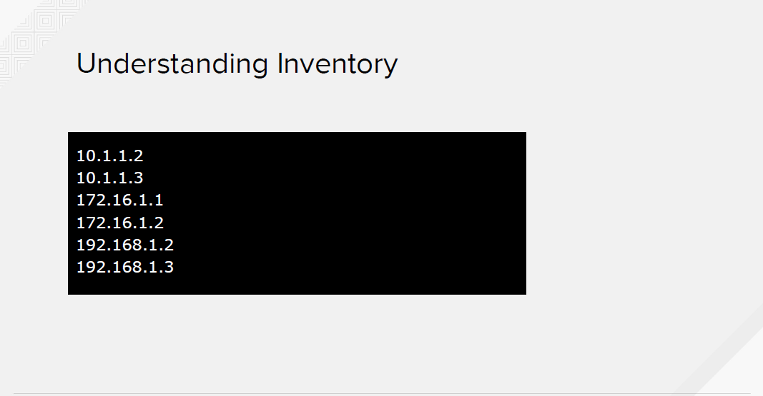
Notes:
Inventory consists of the list of servers that the Playbook will act upon. The servers can be either a simple IP Address or a fully qualified hostname

Slide 20
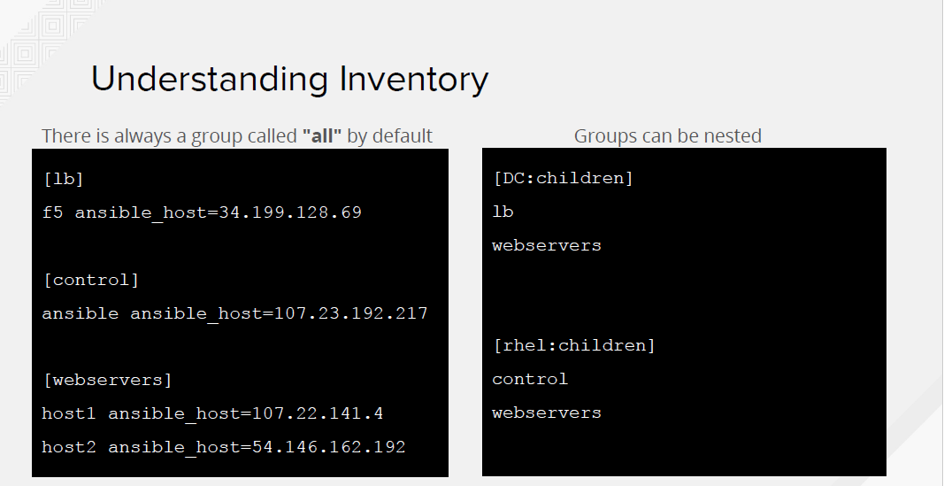

Slide 21
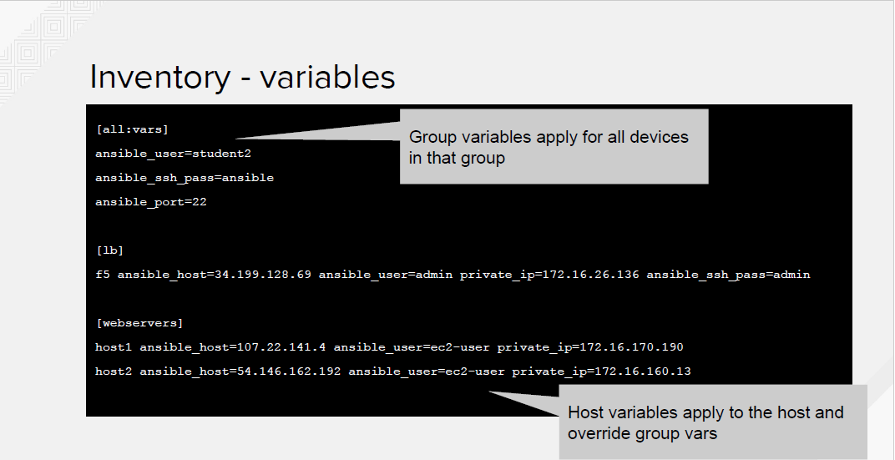

Slide 22
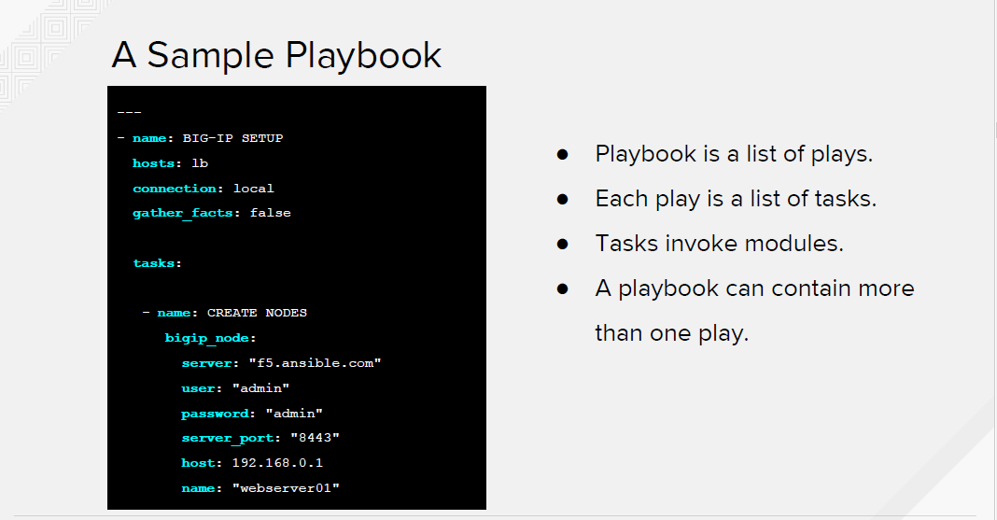

Slide 23
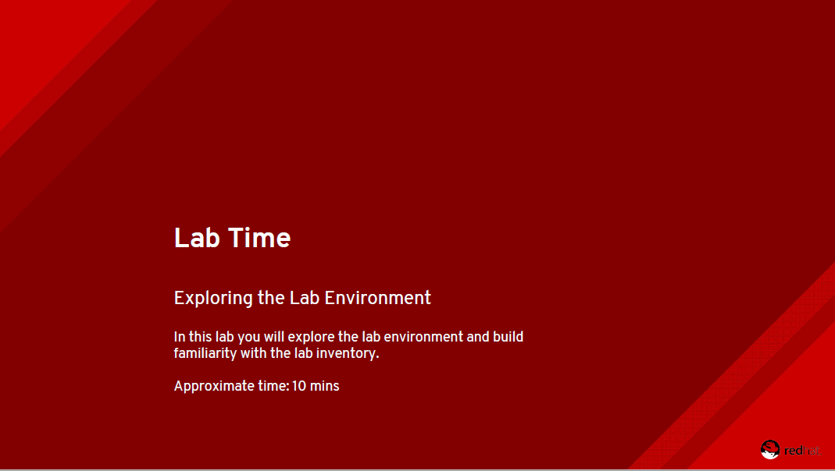

Slide 24
Playbook definition for network automation
Target play execution using hosts
Define the connection: local
About gather_facts

Slide 25
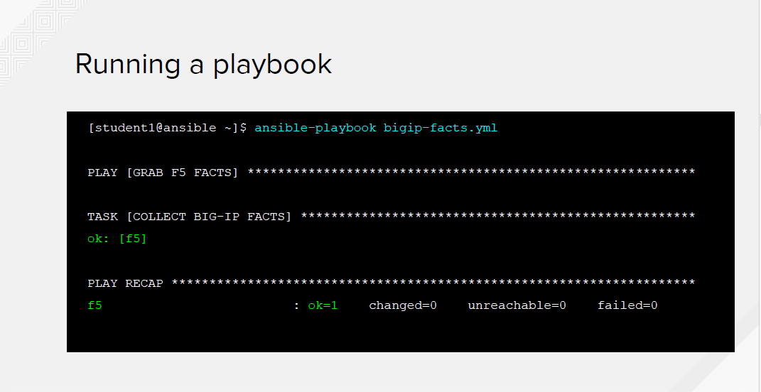

Slide 26
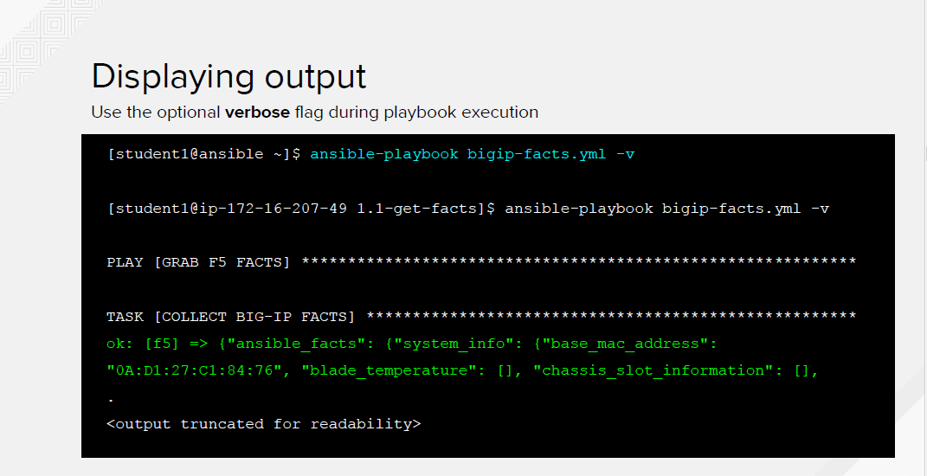

Slide 27
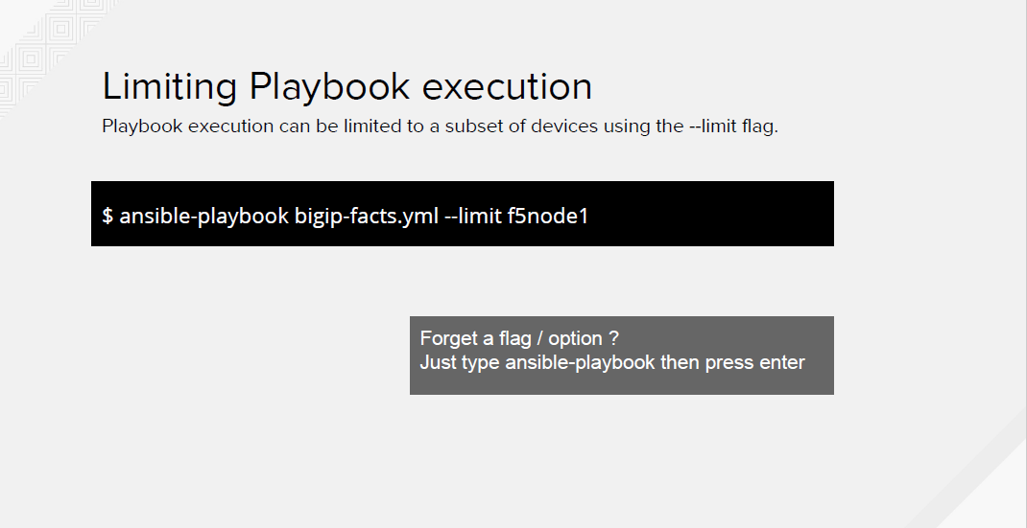

Slide 28
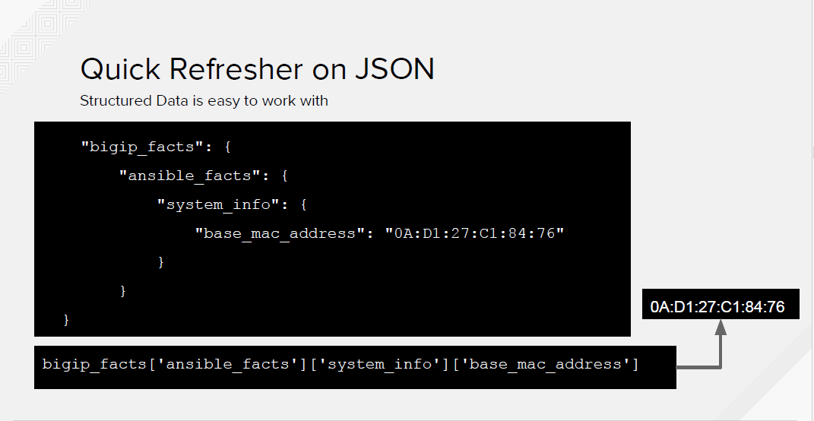

Slide 29
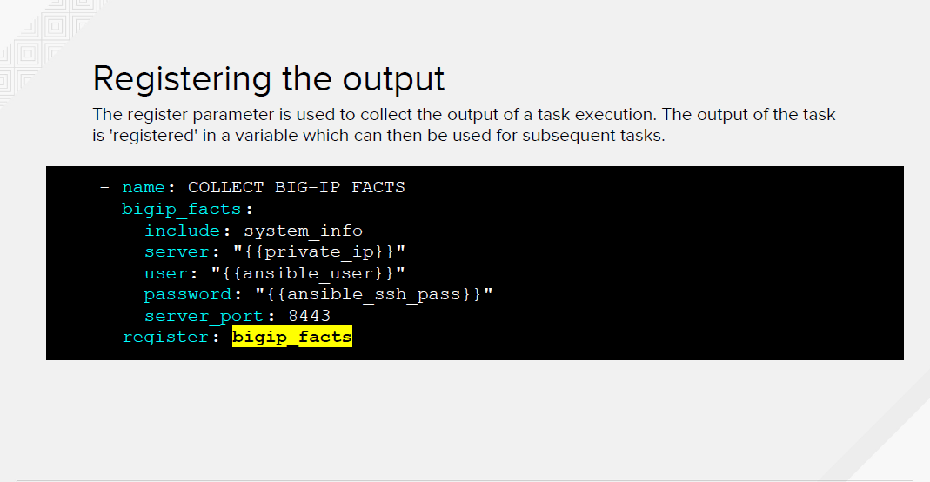

Slide 30
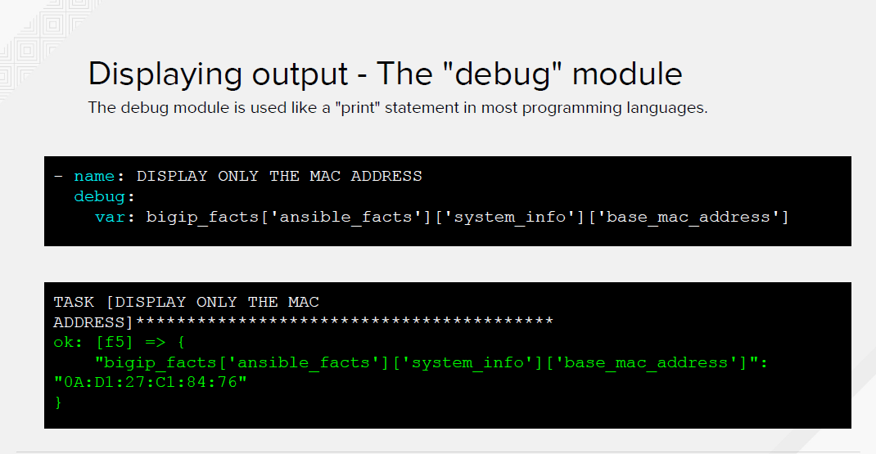

Slide 31
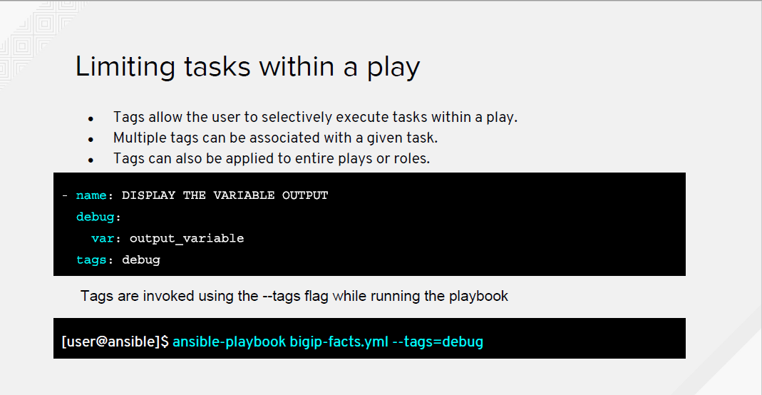

Slide 32
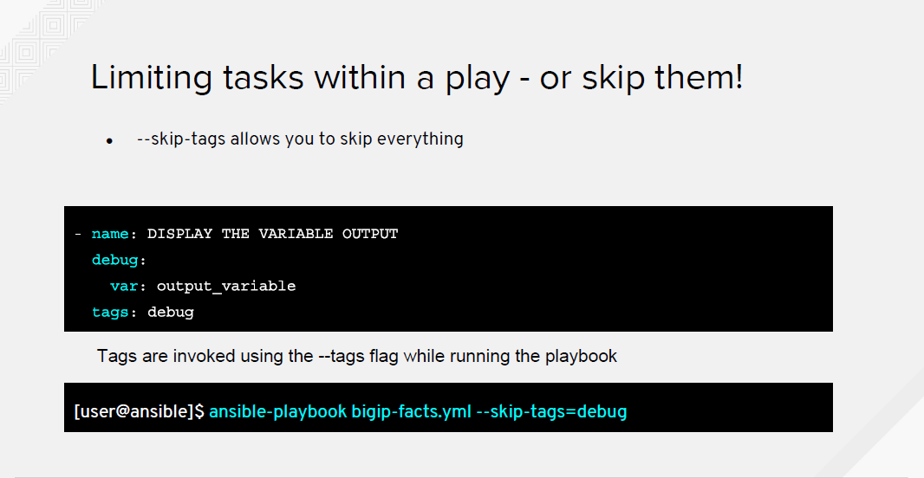

Slide 33
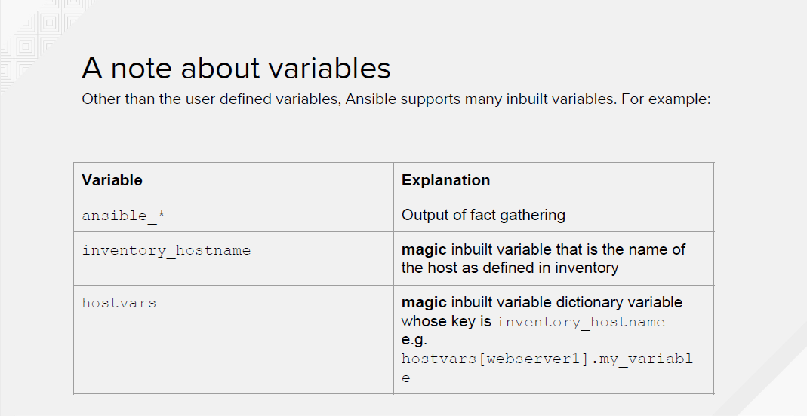

Slide 34
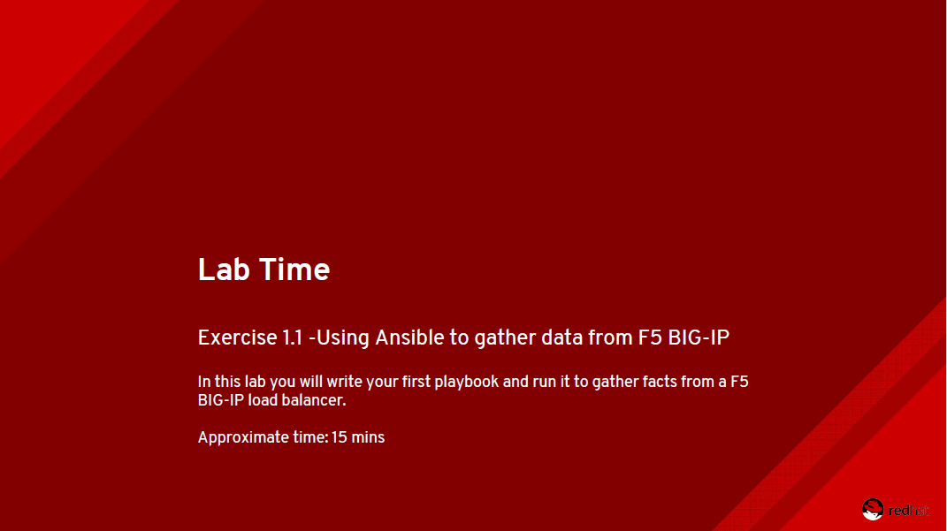

Slide 35
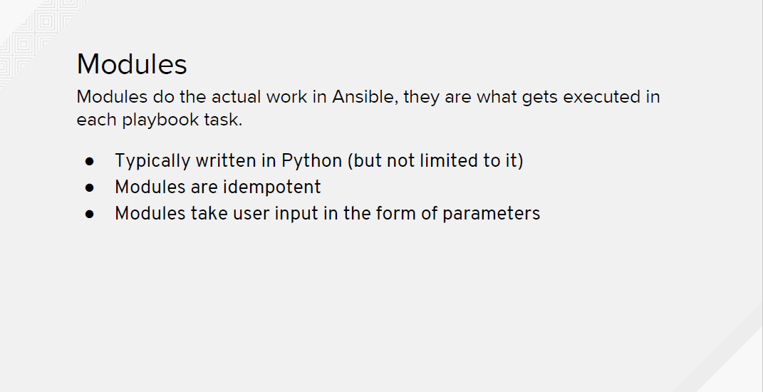

Slide 36
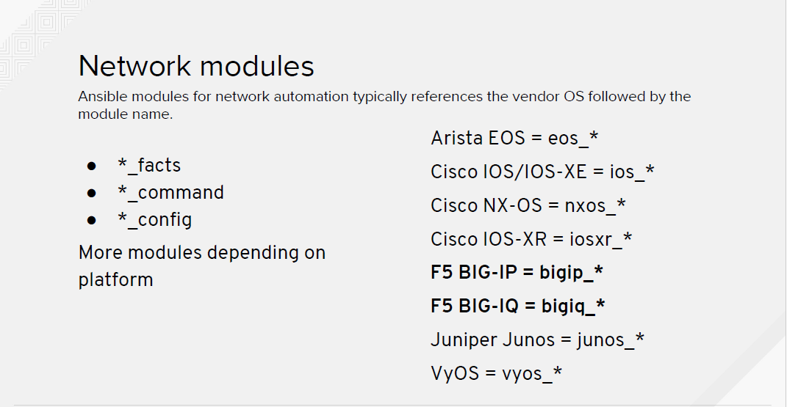

Slide 37
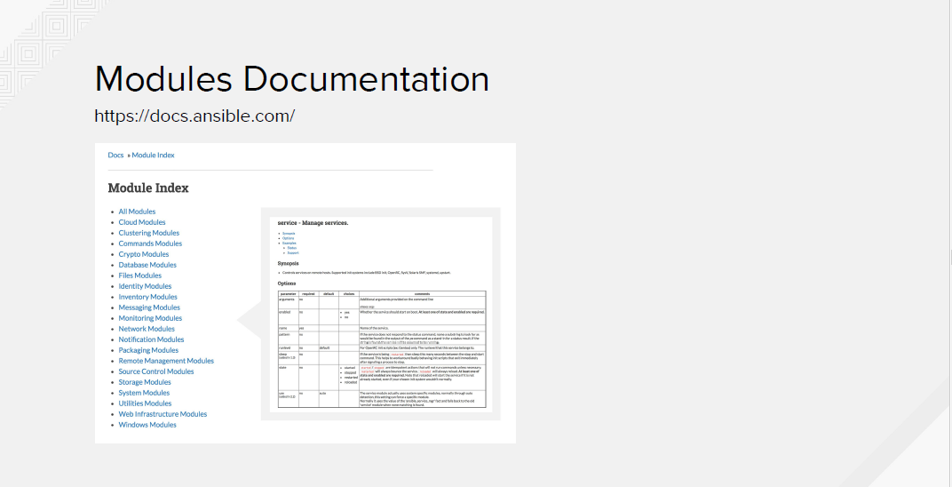

Slide 38
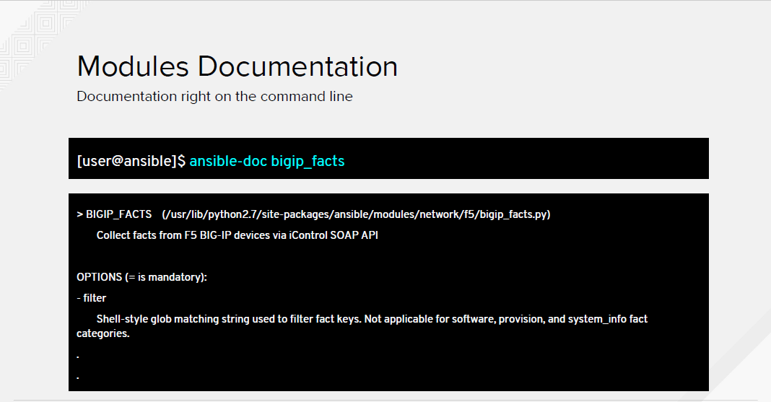

Slide 39
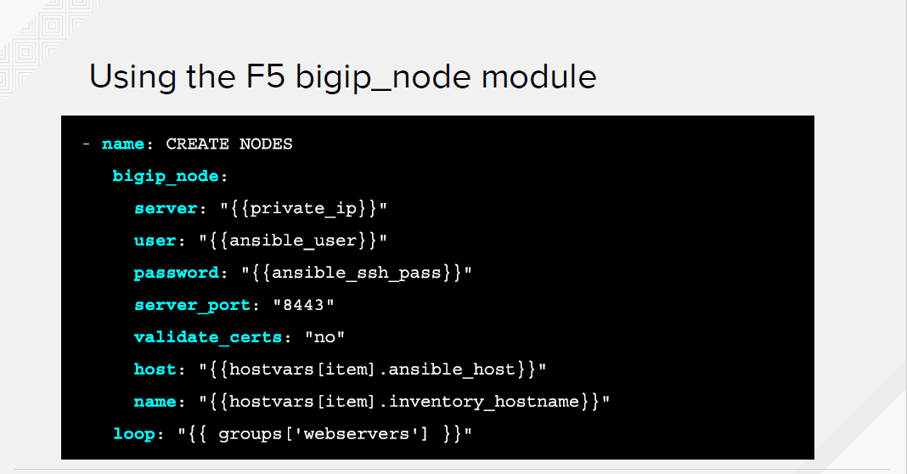

Slide 40
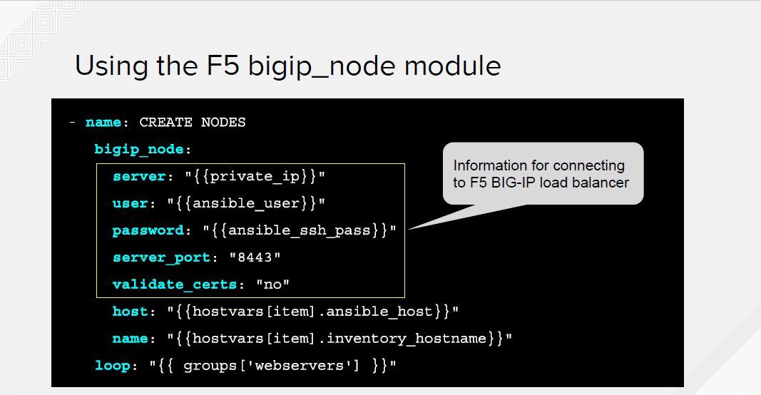

Slide 41
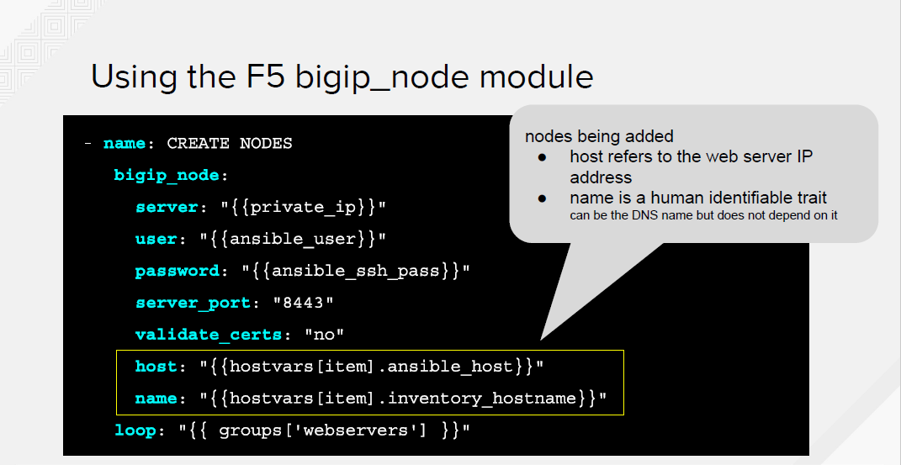

Slide 42
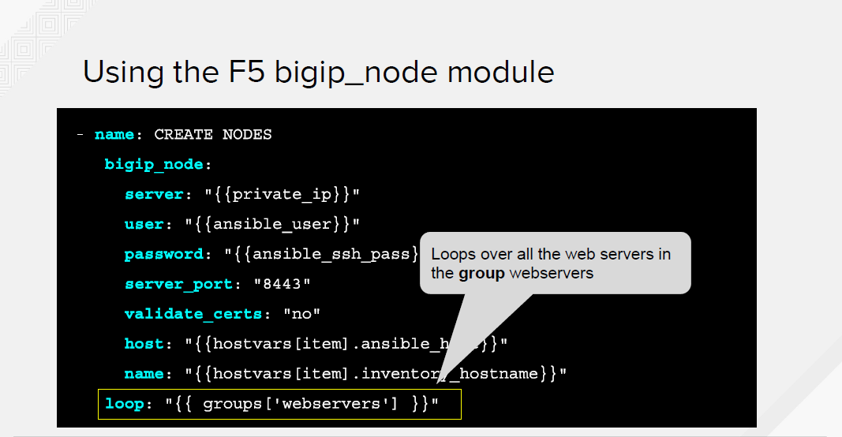

Slide 43
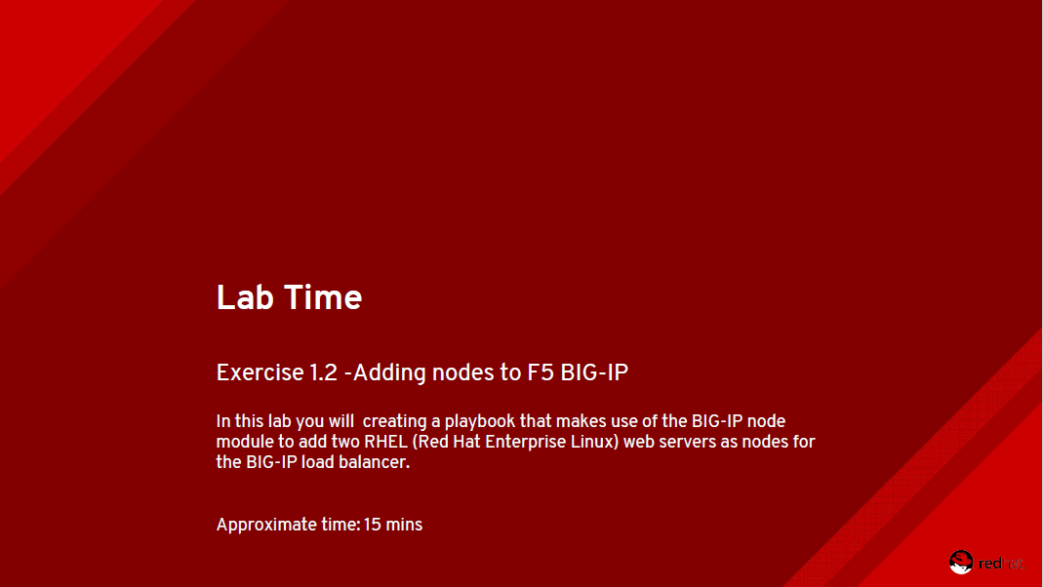

Slide 44
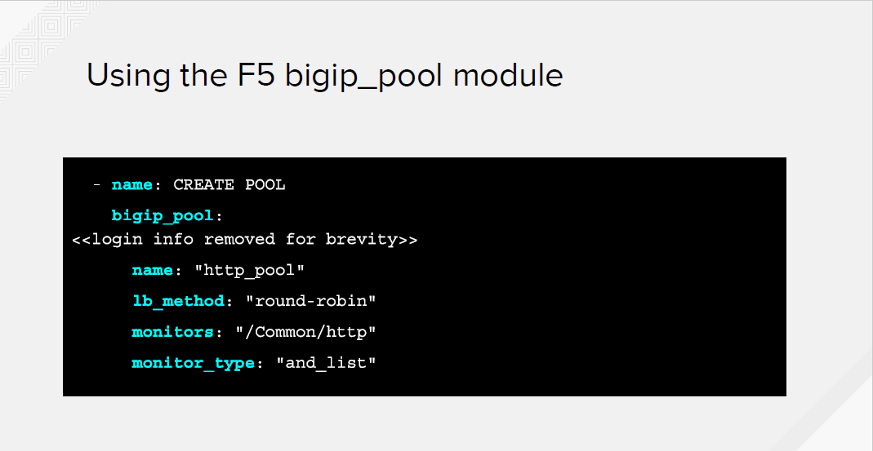

Slide 45
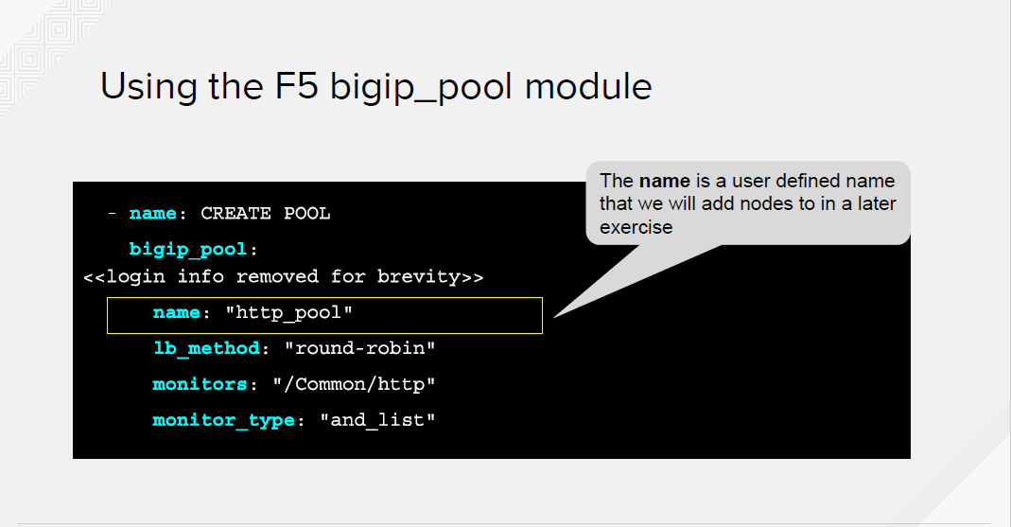

Slide 46
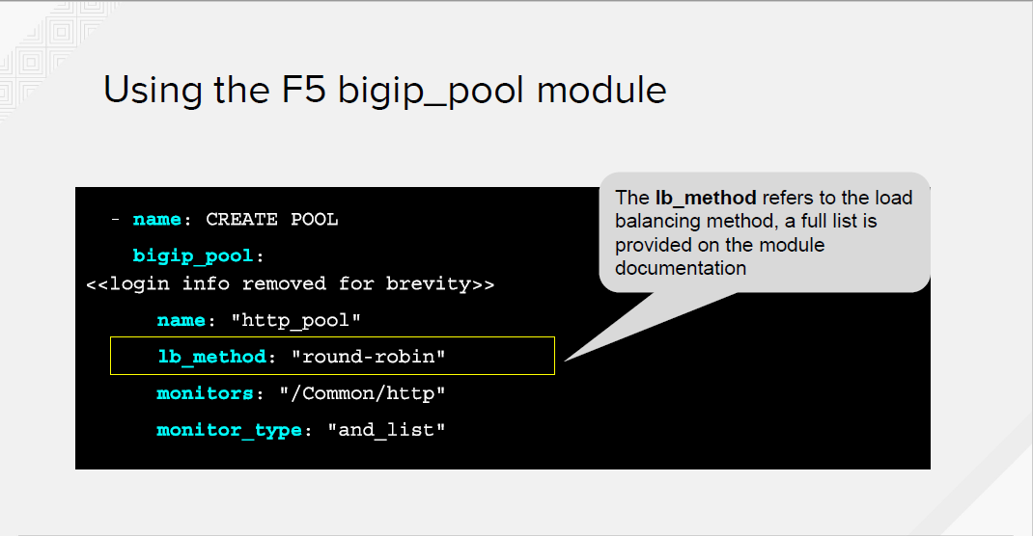

Slide 47
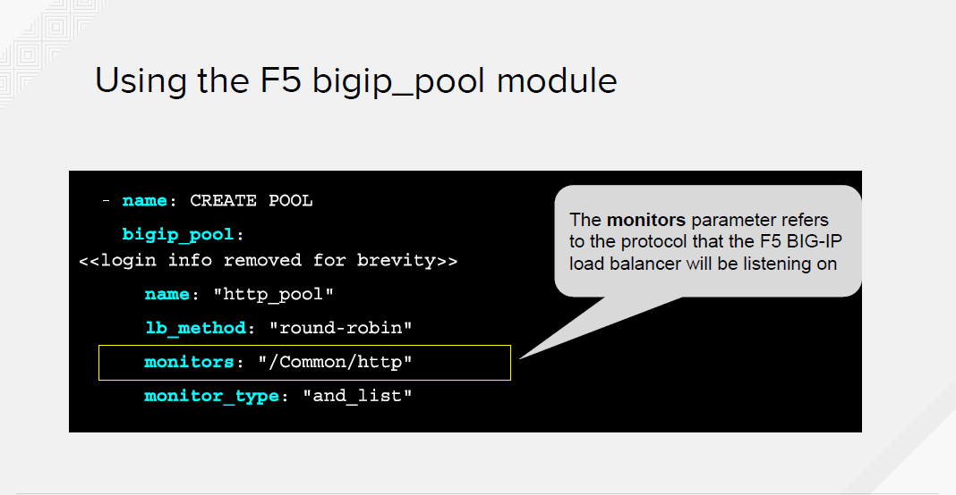

Slide 48
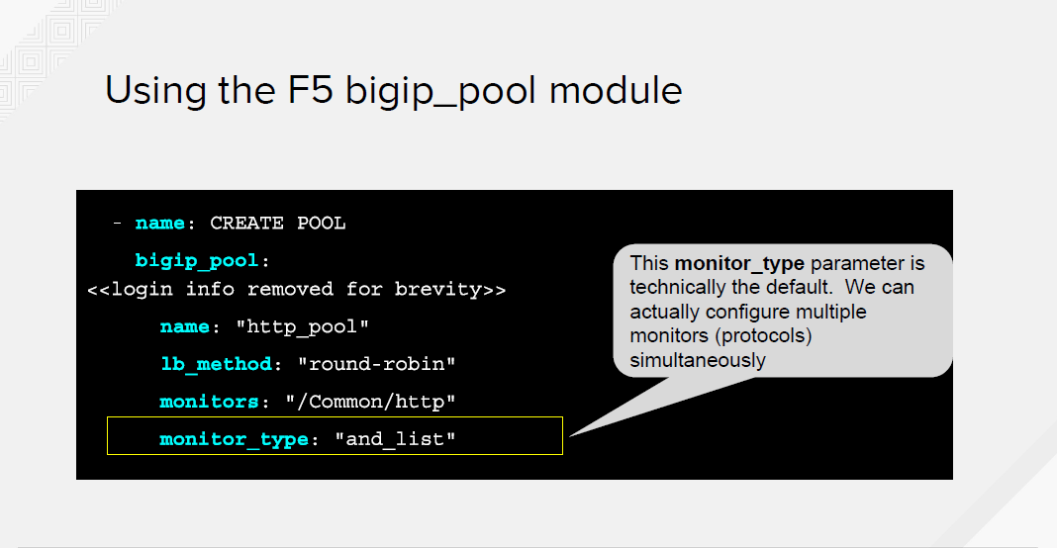

Slide 49
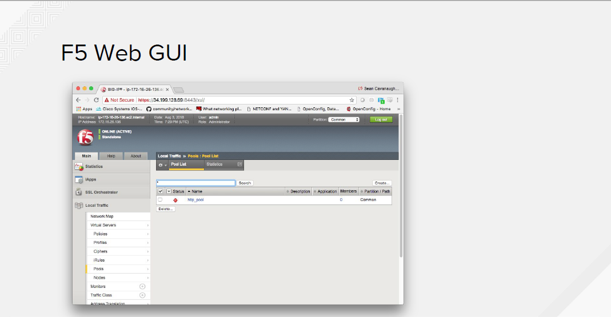

Slide 50
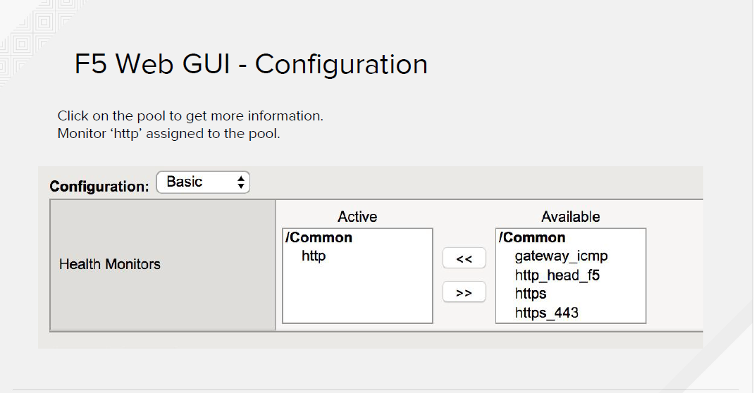

Slide 51
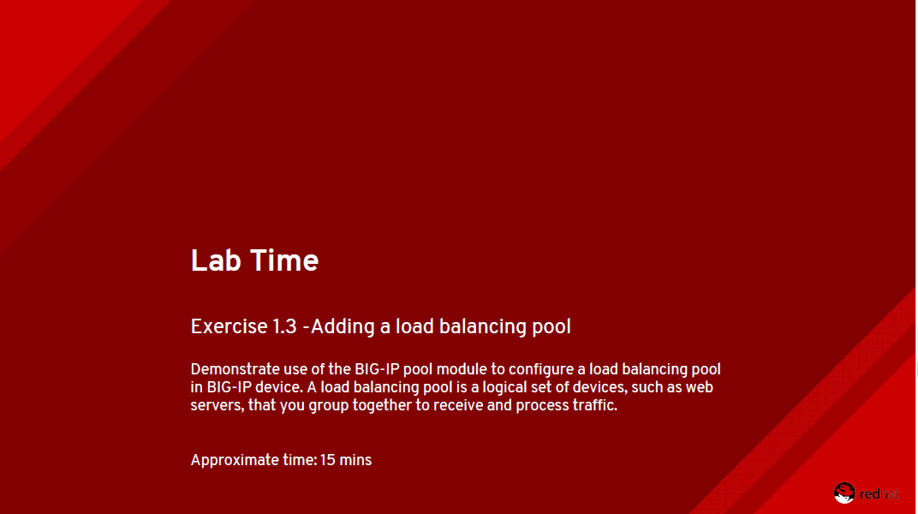

Slide 52
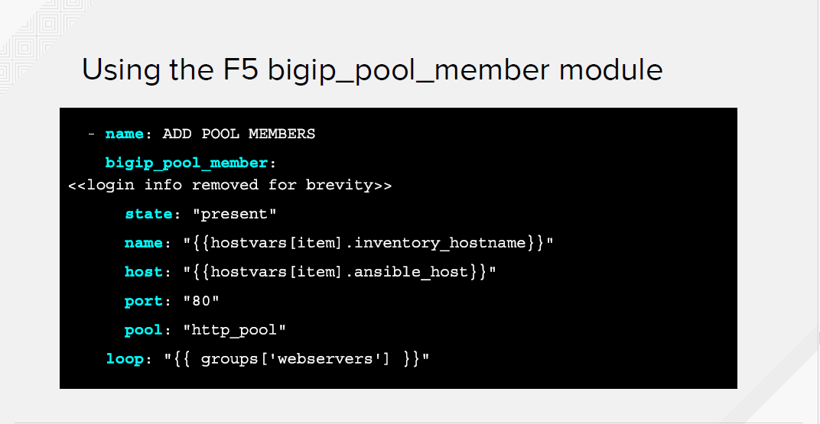

Slide 53
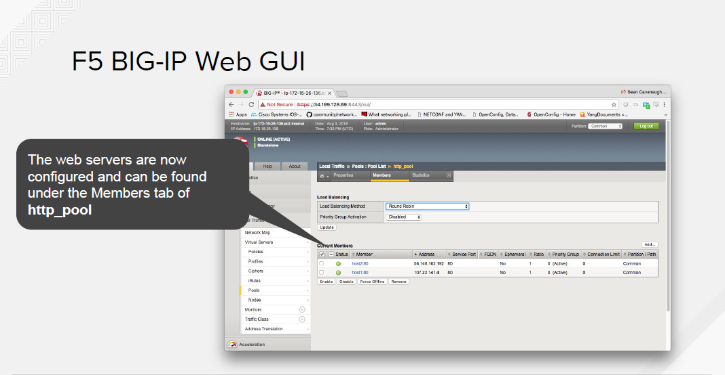

Slide 54
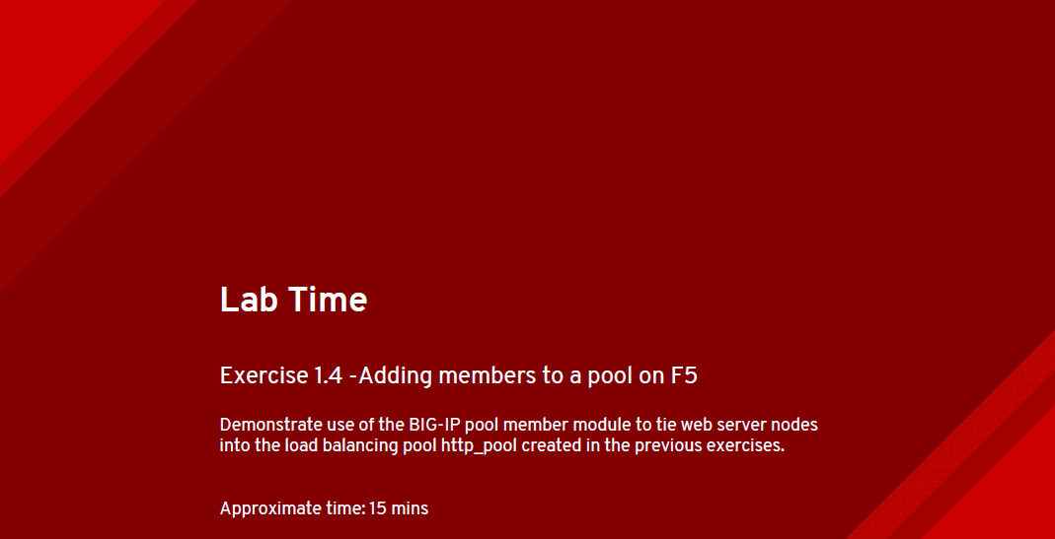

Slide 55
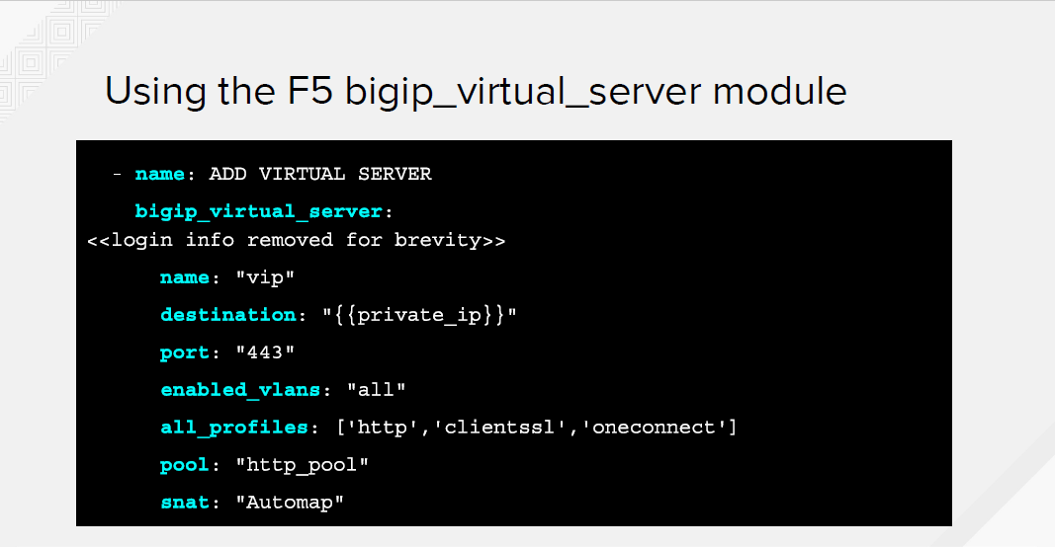

Slide 56
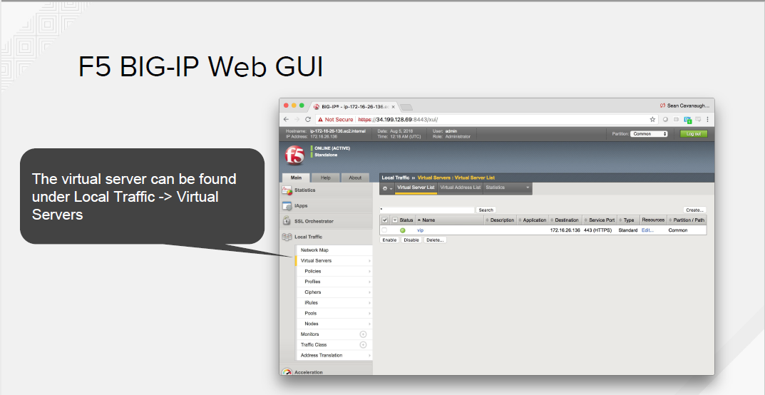

Slide 57
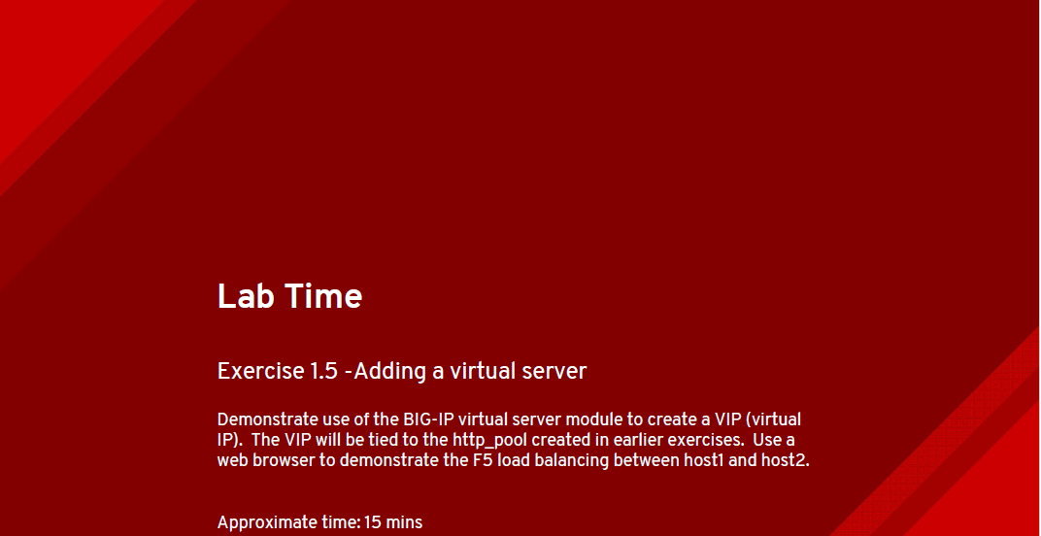

Slide 58
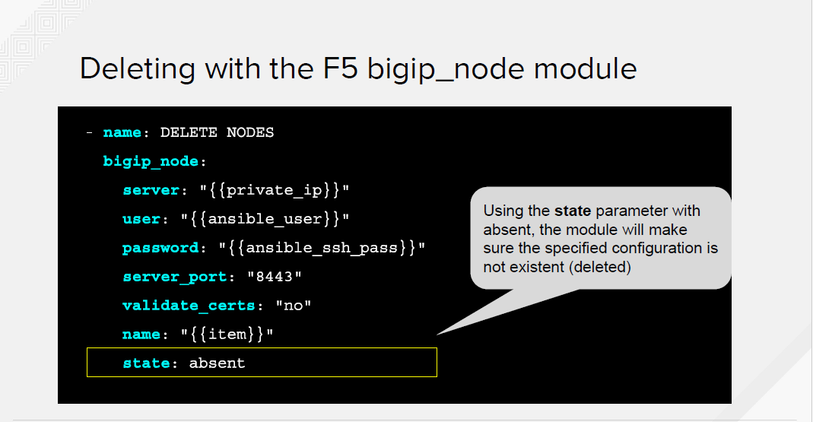

Slide 59


Slide 60


Slide 61


Slide 62


Slide 63


Slide 64


Slide 65


Slide 66


Slide 67


Slide 68


Slide 69


Slide 70


Slide 71


Slide 72


